Slide 1
Experiment Design Considerations
Meeting with First Draft on 04.21.

Slide 2
Goals for the meeting
What outcomes are important to First Draft?
Are there specific outcome questions or knowledge that are high priority?
What specific concepts (messaging elements) from the courses should we prioritize for the mini course?
How do we improve on the delivery of the course?
More quizzes/examples or some other interactive elements
Should we focus on any particular subgroups?
E.g. most susceptible
What would be a minimum effect size that would be useful?

Slide 3
Outcomes
Questions for Discussion
Our (Tentative) Ideas
What outcomes to focus on?
Ability to detect misinformation OR
Ability to recognize the tactics taught in the course
Follow up actions: sharing, fact checking, reporting
Reactions to information: familiarity, emotions, etc
Specific topics and tactics?
How do we effectively test these outcomes?
Fact checks are required for unfamiliar topics.
Mainstream topics too easy to flag as misinfo or have deeply rooted beliefs
Truths are can be written sensationally
How do we balance between difficult, unfamiliar truths vs easy, well recognized misinfo?
Combined Misinfo Question
What is the likelihood that the above headline is true (6 point scale)? (vs true or not & confidence)
Focus outcomes on learning of tactics
more controllable, less variation from prior knowledge
First follow up action
After seeing this, what action would you take first? (Read article, check the source reliability, fact check using other sources, share it, show it to someone, report it, nothing, other)
Additional examples? Better graphs?
Notes:
How do we effectively test these outcomes?
Misinformation depends on knowledge and context. Evidence search/fact check is required for unfamiliar topics.
Truths are difficult to recognize since they can be written with emotions/misinfo tactics. Examples
How do we balance between difficult, unfamiliar truths vs easy, well recognized misinfo?
What topics / pieces of news are most important?
Any particular topic, e.g. vaccines, COVID
Additional examples
What tactics to inoculate against?

Slide 4
Outcomes
Questions for Discussion
What outcomes to focus on?
Ability to detect misinformation
Ability to recognize the tactics taught in the course
Follow up actions: sharing, fact checking, reporting
Reactions to information: familiarity, emotions, etc
How do we effectively test these outcomes?
Misinformation depends on knowledge and context. Evidence search/fact check is required for unfamiliar topics.
Truths are difficult to recognize since they can be written with emotions/misinfo tactics. Examples
How do we balance between difficult, unfamiliar truths vs easy, well recognized misinfo?
What topics / pieces of news are most important?
Any particular topic, e.g. vaccines, COVID
Do you have specific pieces for us to use?
What tactics to inoculate against? (How challenging test to use?)

Slide 5
Treatments (Content)
Questions for Discussion
Our (Tentative) Ideas
What course elements/treatments should the experiment focus on?
The pilot focused on the Tactics and Emotions course (and also tested a course which combined elements of both) – are there any other courses/content to consider?
The experiment is time-constrained – are their particular elements of the Tactics and Emotions courses First Draft would prefer to test?
Other studies have focused on polarisation, invoking emotions, conspiracy theories, trolling, deflecting blame, and impersonation
The treatment effect may be stronger if the experiment focuses on delivering a limited scope effectively
The pilot and prior literature suggest that the tactics course may yield a more significant treatment effect (though there might be important heterogeneites)
Findings from the pilot follow

Slide 6
Treatments (Delivery)
Questions for Discussion
Our (Tentative) Ideas
Is there anything specific “delivery method” First Draft would prefer? How can the survey best approximate a text-message-based course?
Should the course include a quiz or other interactive elements?
The literature suggests interactive delivery is likely most effective (prompting questions, examples, follow up questions)
Quizzes in the pilot showed mixed results; this may just be driven by low sample size
The survey could “structure” the course with headings and other signposts
Potentially focus on 3 main takeaways with a prompting question for each
Findings from the pilot follow

Slide 7
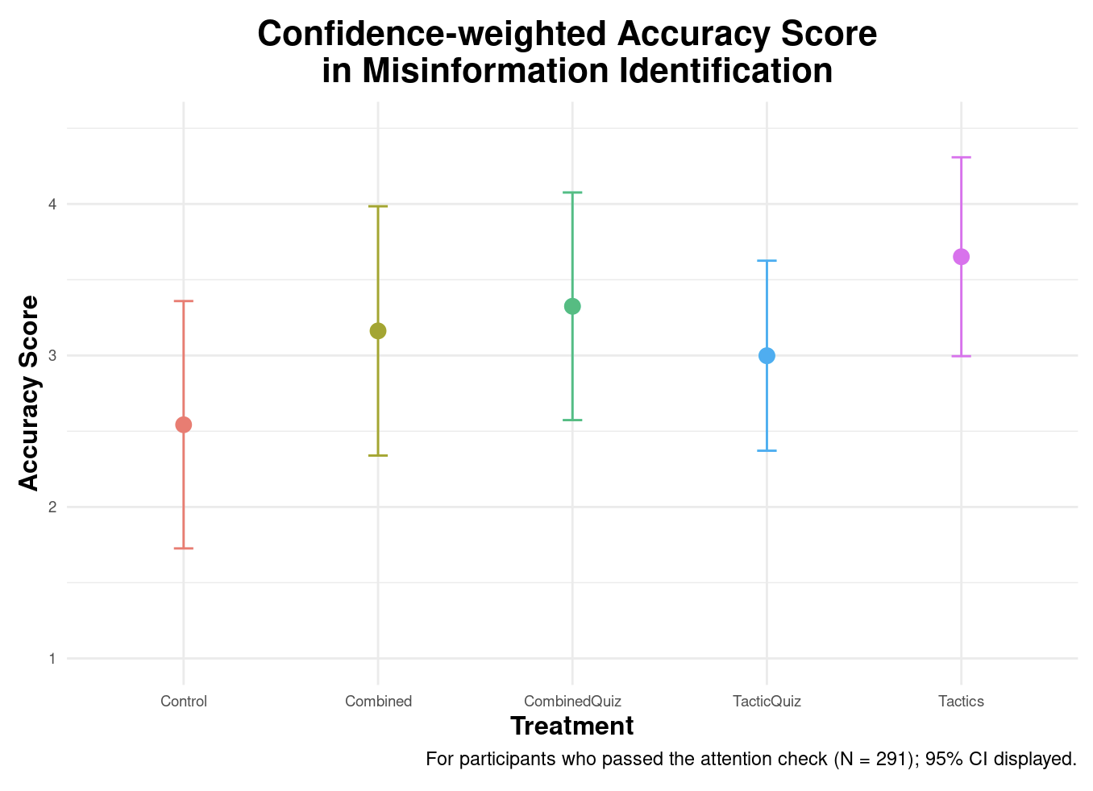
Tactics treatment performed best
Results not statistically significant after multiple hypothesis correction

Slide 8
Scale of Accuracy score
For each question, participants picked one of 3 options identifying the post as misinformation.
Additionally, they picked how confident they are of their choice on a scale from 1 to 10.
The Accuracy Score was calculated as the weighted average of their score of identifying the question (+1 for correct classification, -1 for misclassification and 0 if they weren’t sure)
The final output was the average over the 10 questions (misinformation and true information questions).
The minimum score is -10 (if the participant labeled all questions incorrectly and was confident of their response) and the maximum score is +10.

Slide 9
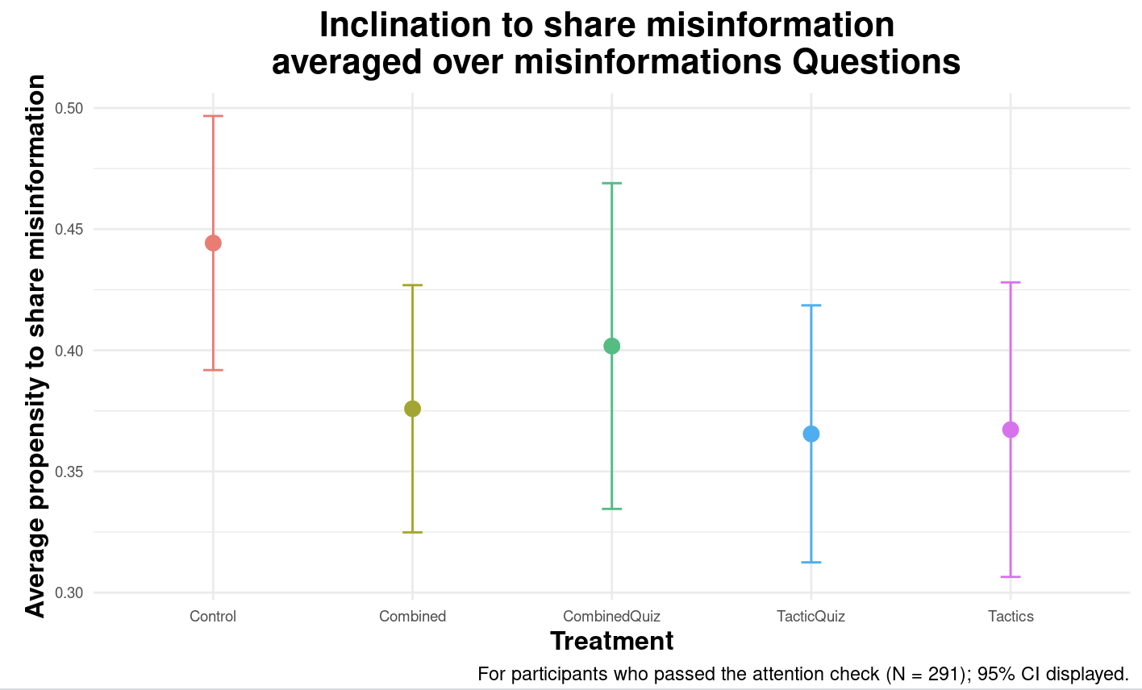
Results not statistically significant after multiple hypothesis correction
More graphs

Slide 10
Scale of Propensity to share misinformation
For each question, participants were asked how likely they are to share the post on social media.
The participants had 5 categories to choose from (increasing linearly by likeliness to share)
The reported outcome measures the average tendency to share for the misinformation questions.
The minimum score is 1 (if the participant chooses to share for sure all the misinformation posts).

Slide 11
Comparing Accuracy Score across tactics
Accuracy scores for each type of misinformation tactic used in the survey.
Questions were classified according to the type of misinformation, and the score for that question shows the performance in response to that type of tactic.
Tactic | Significant Treatment (0.10 significance)
Imposter content
Strong emotions | Tactics, Combined Quiz
False expert | Tactics
Misleading graphics | Tactics, Combined Quiz, Combined
Conspiracy theory | Tactics, Combined Quiz, Combined

Slide 12
Treatments - Subgroups
Is there a specific subgroup you would like us to focus on?
Hypotheses about what might work best for specific subgroups? Or look for heterogeneities based on the data?
Most susceptible ones?
Any other subgroup considerations?
Findings from the pilot (graphs)
Our ideas
Pre-screening not an option.
Do stratification.

Slide 13
Important covariates from pilot
Bold = Showed most promise in pilot analysis
Trust in Fauci
Political Leaning
Trust in scientists
Education
Trust in Donald Trump
Age
Propensity to post on Social Media
Race
Citizenship
Gender
Sexuality
Income
Religion
Trusted News Sources
Self-Identified Misinfo Susceptibility
COVID and Climate Change views

Slide 14
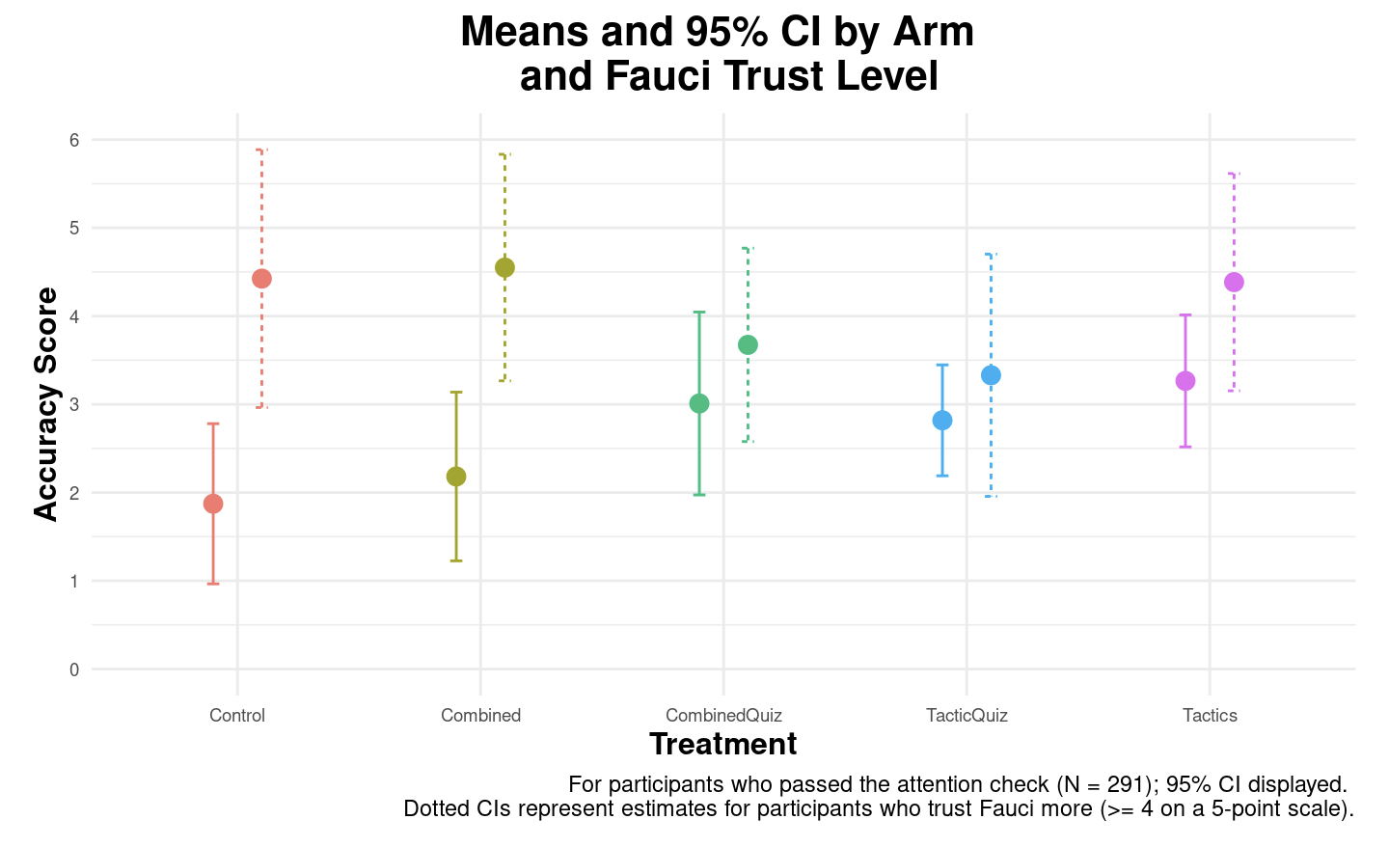

Slide 15
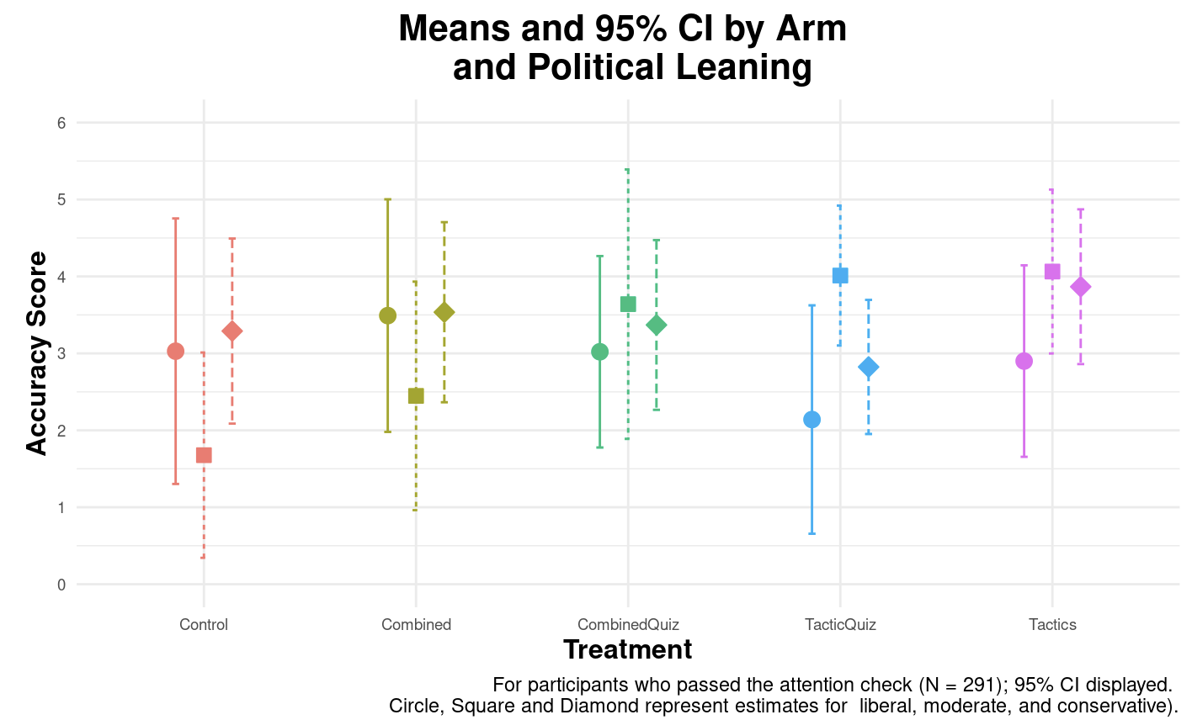

Slide 16
Other considerations
What would be the minimum useful effect size?
E.g. % change in likelihood of posting misinfo or incorrectly identifying
If big, we can test more hypotheses
Anything else?
Next steps
Would you like to see our draft design?
Can we email you?
Our ideas
Constraints: sample size of ~1000, total length of 15 minutes
Power calc
Notes:
e.g. improved discernment between mainstream and false news headlines among nationally representative sample in the United States (by 26.5%))

Slide 17
Additional Reference Material
Power
Pilot content sample
Additional graphs
Outcome examples

Slide 18
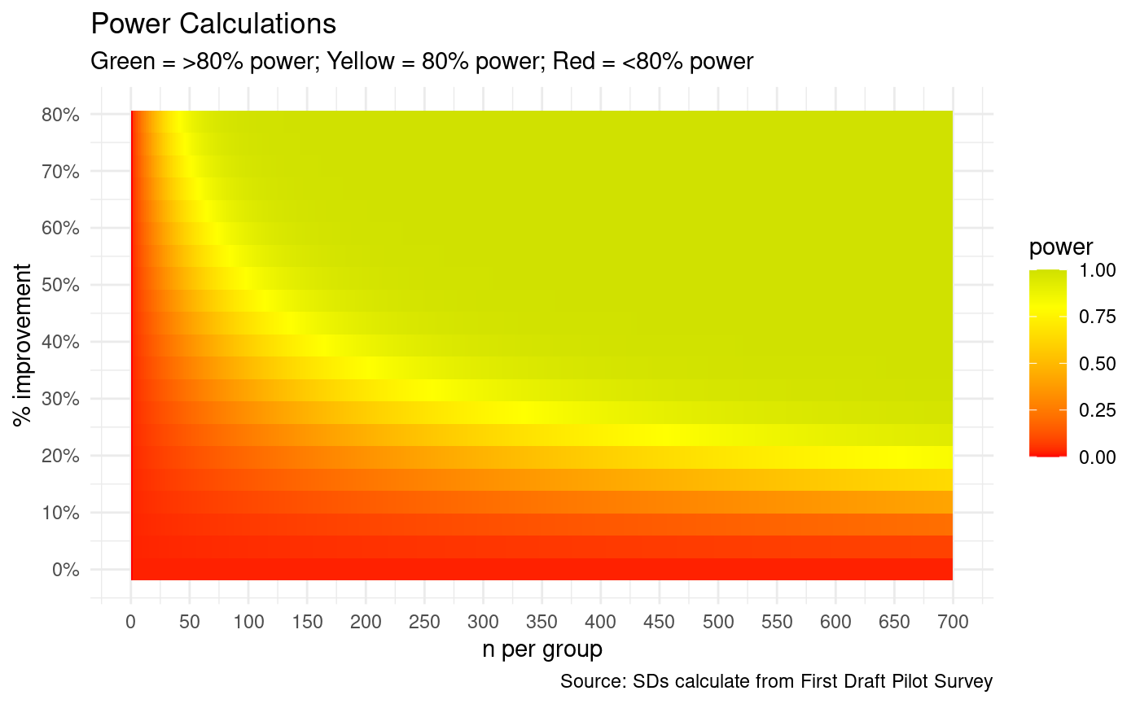
Considerations
Back

Slide 19

Considerations
Back

Slide 20
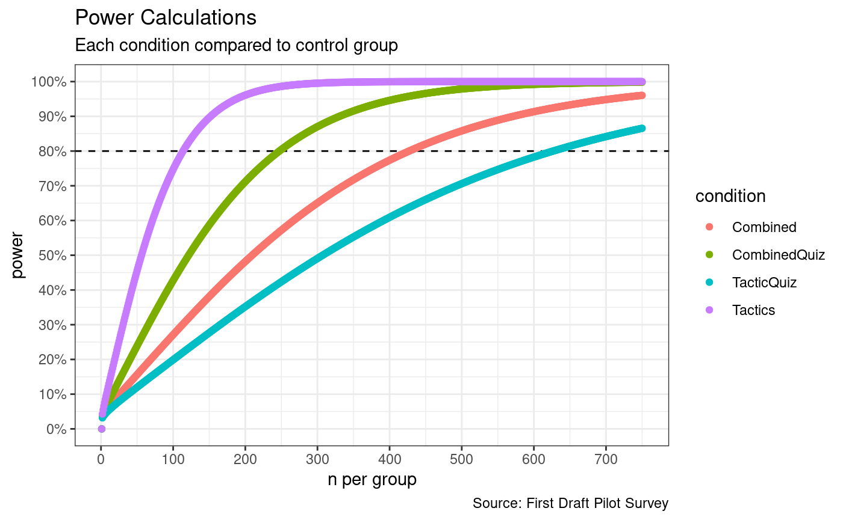
Back

Slide 21
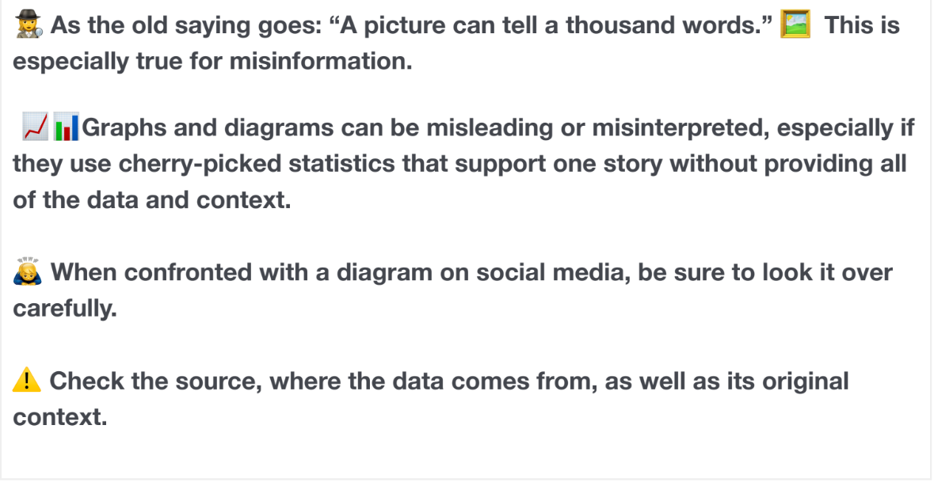
Back

Slide 22
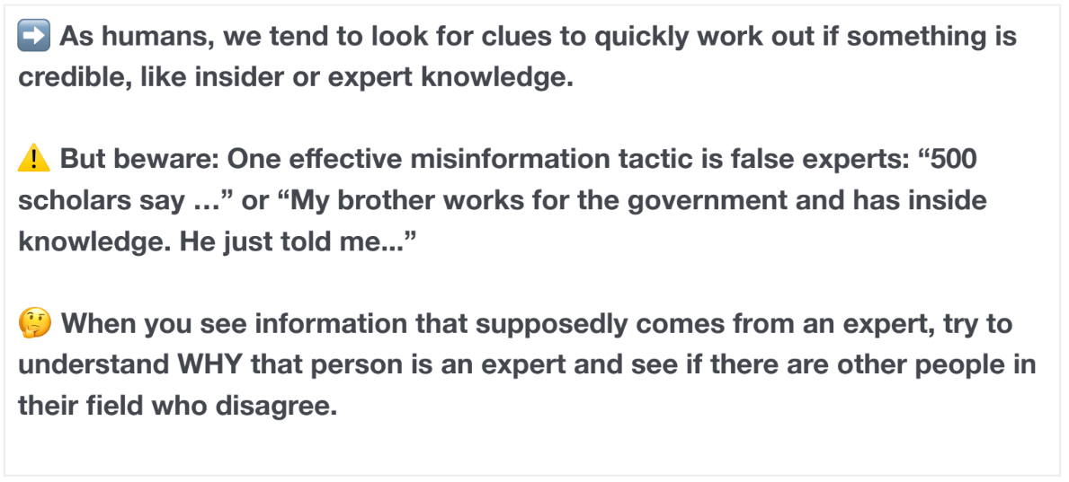
Back

Slide 23
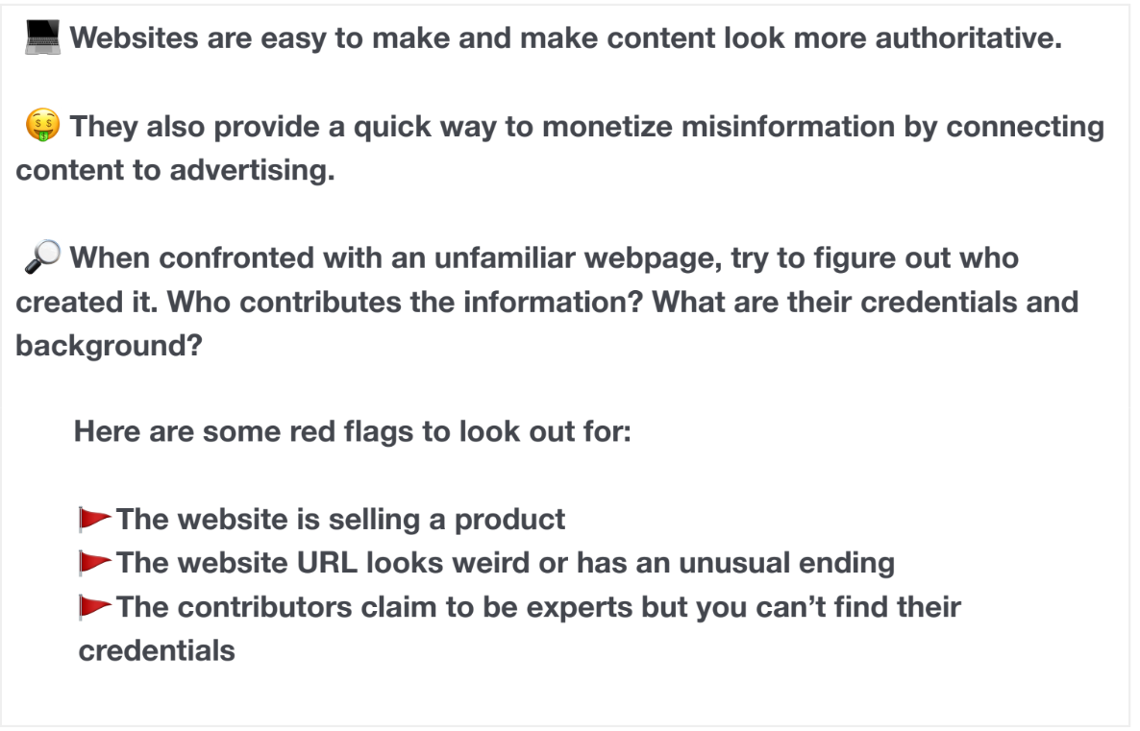
Back

Slide 24
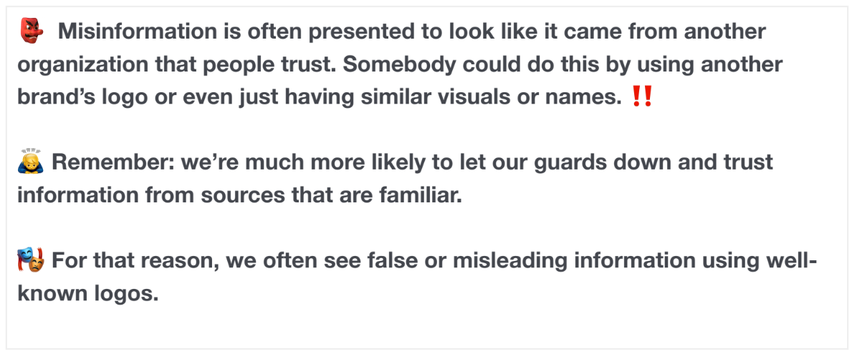
Back

Slide 25
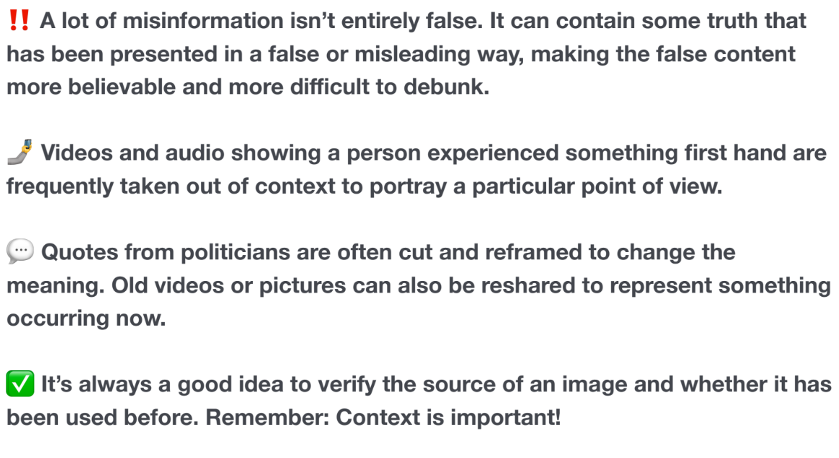
Back

Slide 26
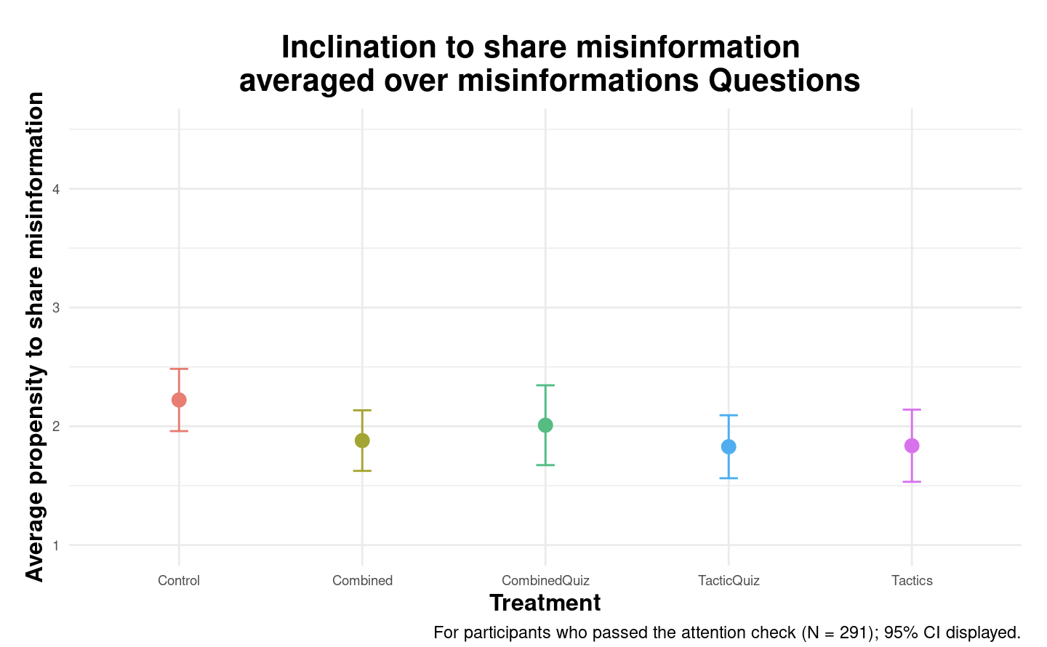
Results not statistically significant after multiple hypothesis correction
Back to main
Back

Slide 27
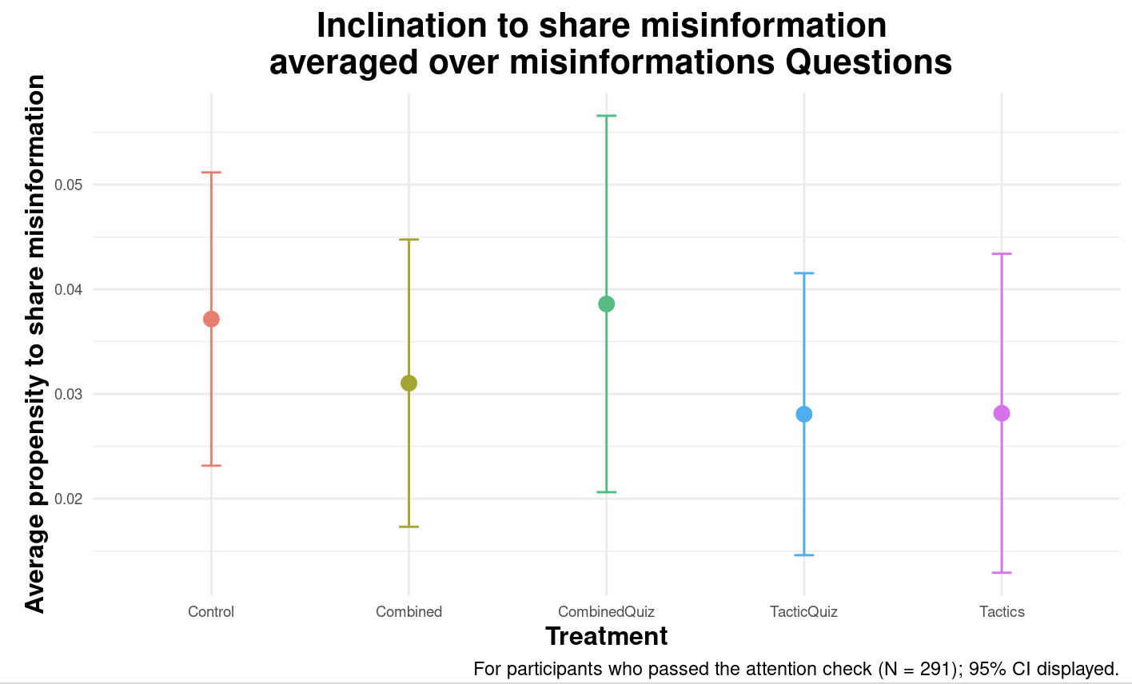
Binarized
Results not statistically significant after multiple hypothesis correction
Back to main
Back

Slide 28
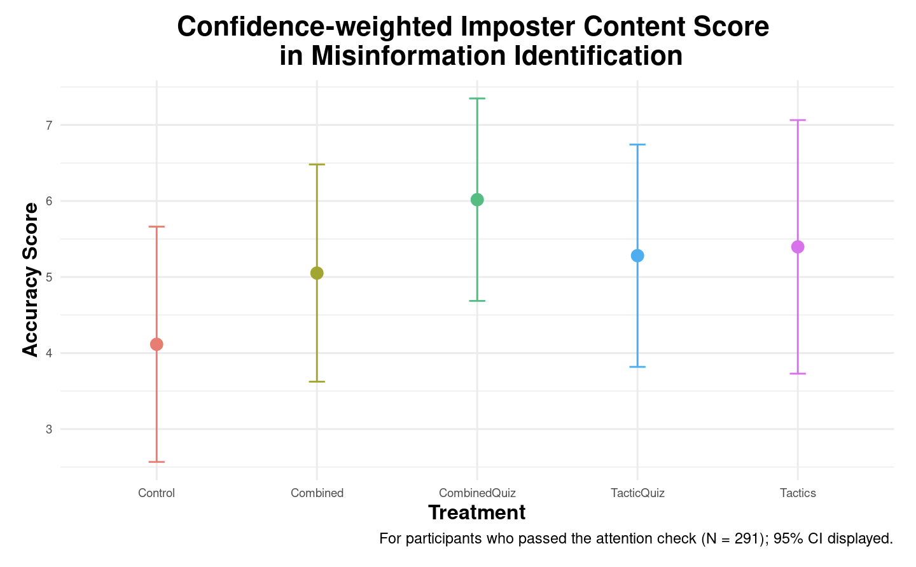
Back
Notes:
Q1

Slide 29
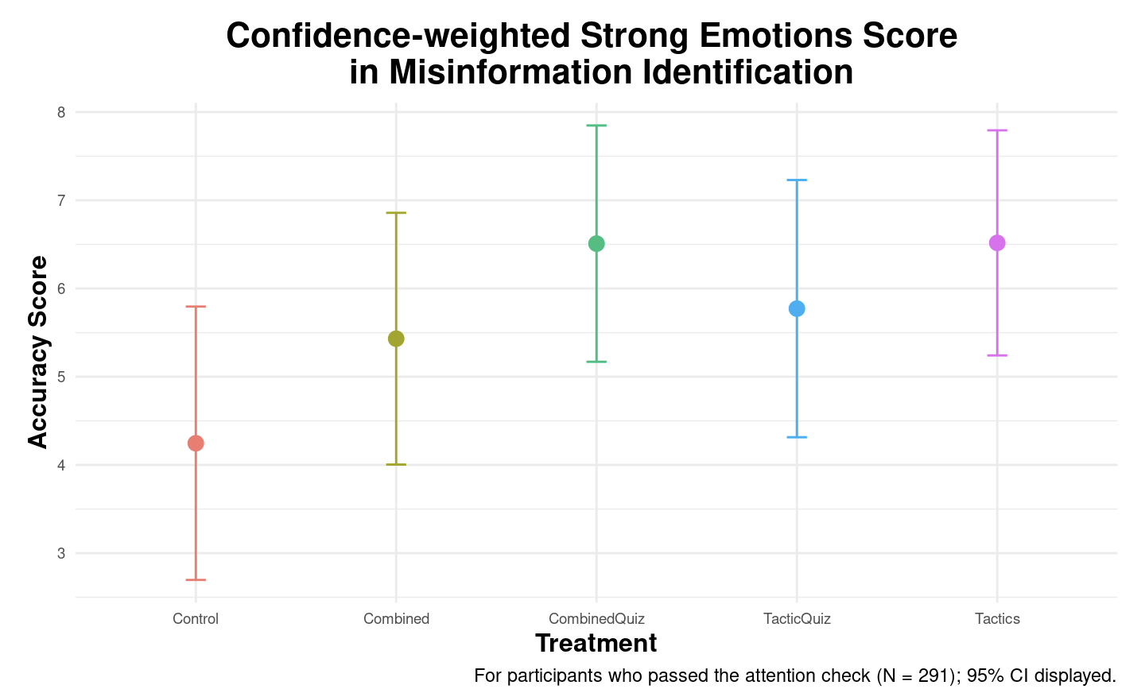
Back
Notes:
Q 4

Slide 30
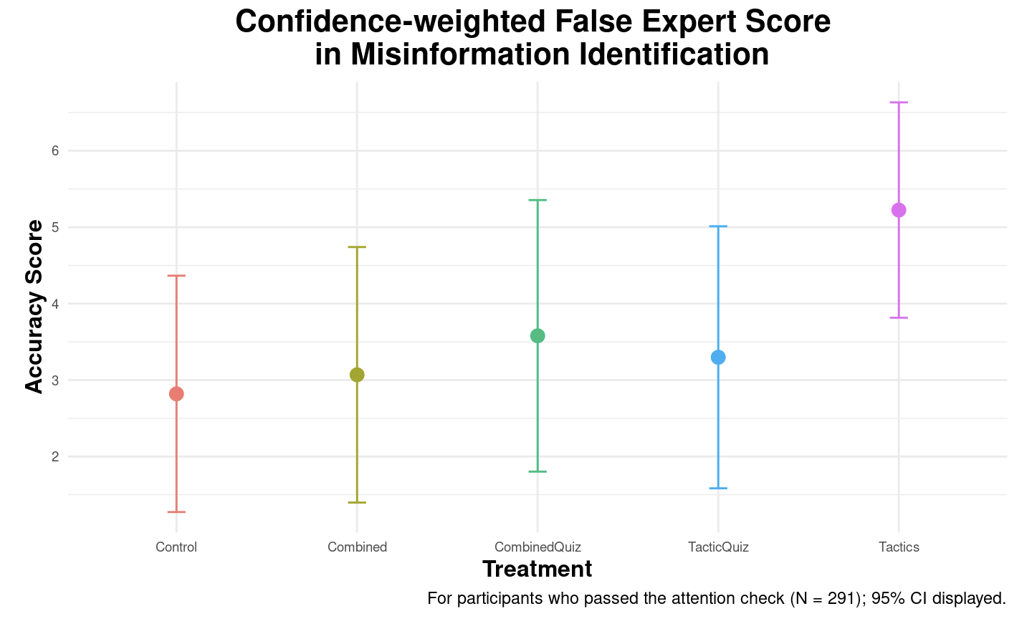
Back
Notes:
Q 5

Slide 31
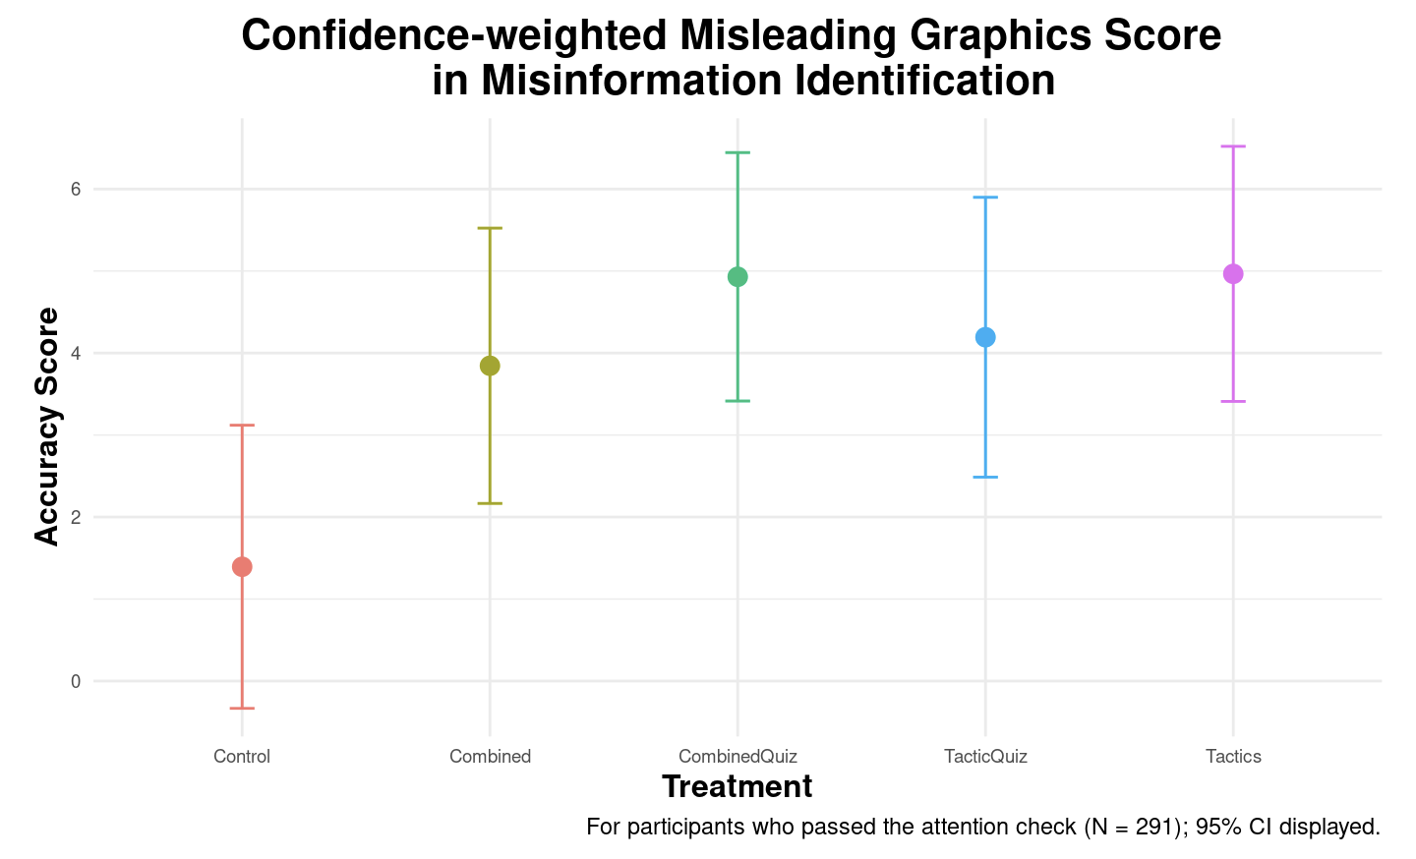
Back
Notes:
Q 8

Slide 32

Back
Notes:
Q 7,9

Slide 33
Facts: 3 each
Back

Slide 34


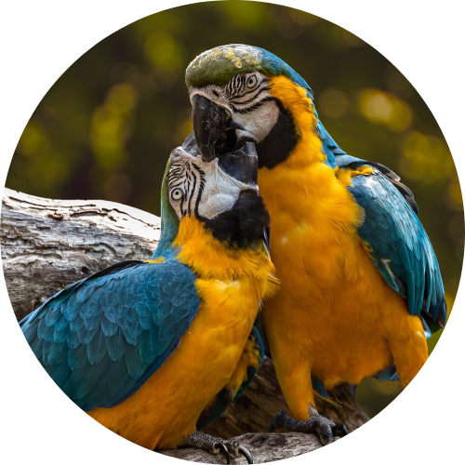
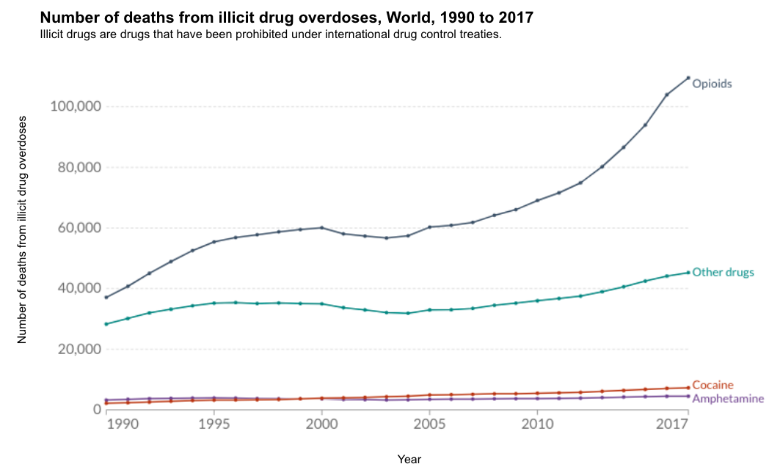
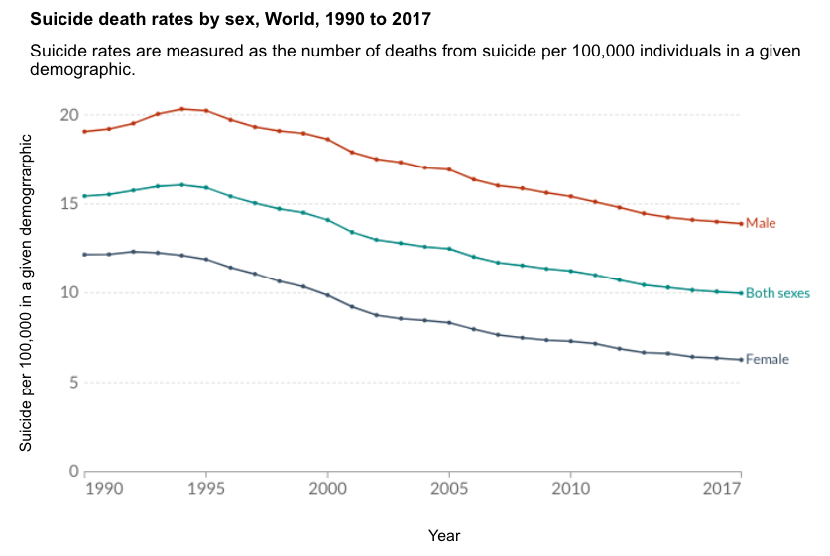
True Charts, Neutral Tone
Topics: opioids, death, drugs
Topics: Gender, Suicide, mental health
JH Public Health
4 hrs
Nila
3 hrs
Global overdose deaths from opioids more than doubled from 1990 until 2017.
This graph shows the suicide death rates by sex, globally from 1990-2017. Since 1990, men have shown a higher propensity towards suicide than women.
Back

Slide 35


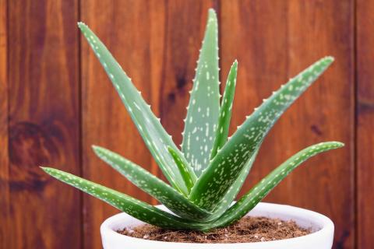
Emotional Truths
Javier
7 hrs
Oliver
8 hrs
...
...
Don’t be duped by the profit-seeking of big pharmaceutical companies. Aloe vera often fixes burns much faster than conventional medicine.
Doctors would NEVER tell you this, but you don’t really need to avoid alcohol. when taking antibiotics. Only certain antibiotics react poorly with alcohol.
Topics: antibiotic, alcohol
Topics: Big Pharma, aloe vera, Natural remedies
Outcomes Slide

Slide 36

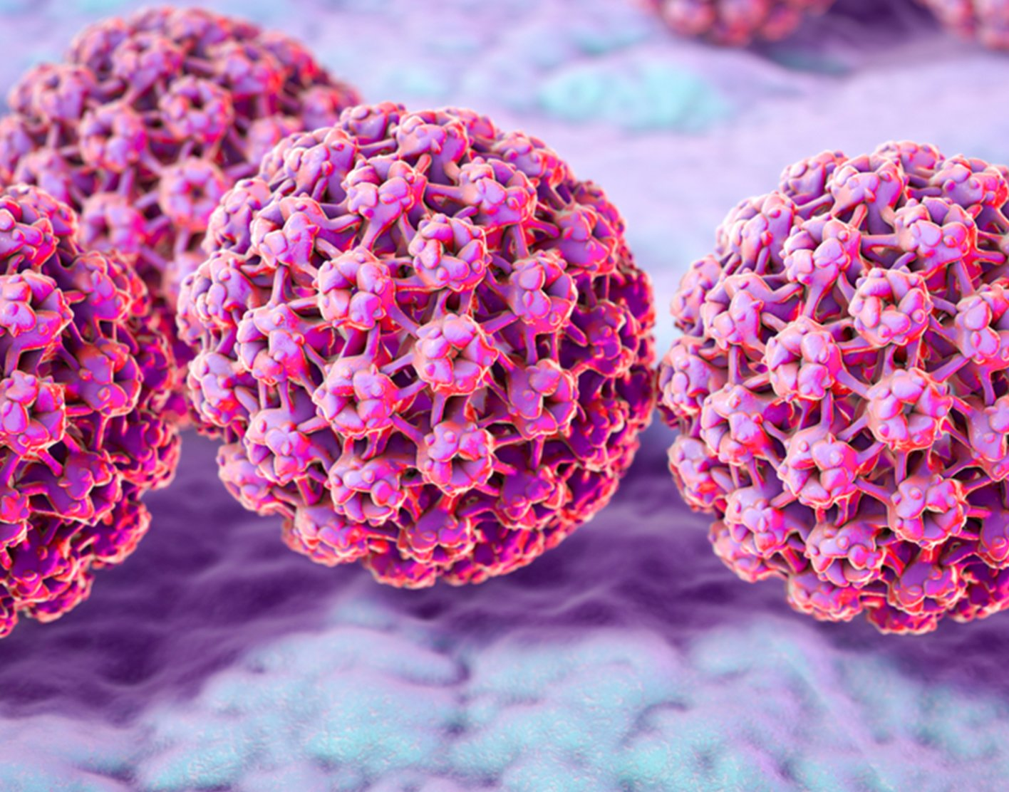


Myth Debunking
Lolita
4 hrs
Sunne
4 hrs
...
MYTH: Sitting close to the TV does NOT damage your eyes, but it may cause eyestrain.
It’s a myth that your heart briefly stops when you sneeze. The fact is, sneezing makes the pressure in our chest change. These small changes can alter blood flow, changing the rhythm of your heartbeat. So even if it feels like your heart skips a beat when you sneeze, it actually doesn’t.
5 popular myths debunked!
Medical doctor Yasmin Ahmadi helps debunk some common myths about health and wellness.
Topics: heart
Topics: eyes
Outcomes Slide

Slide 37
Misinfo Emotions: 2 each
Back

Slide 38

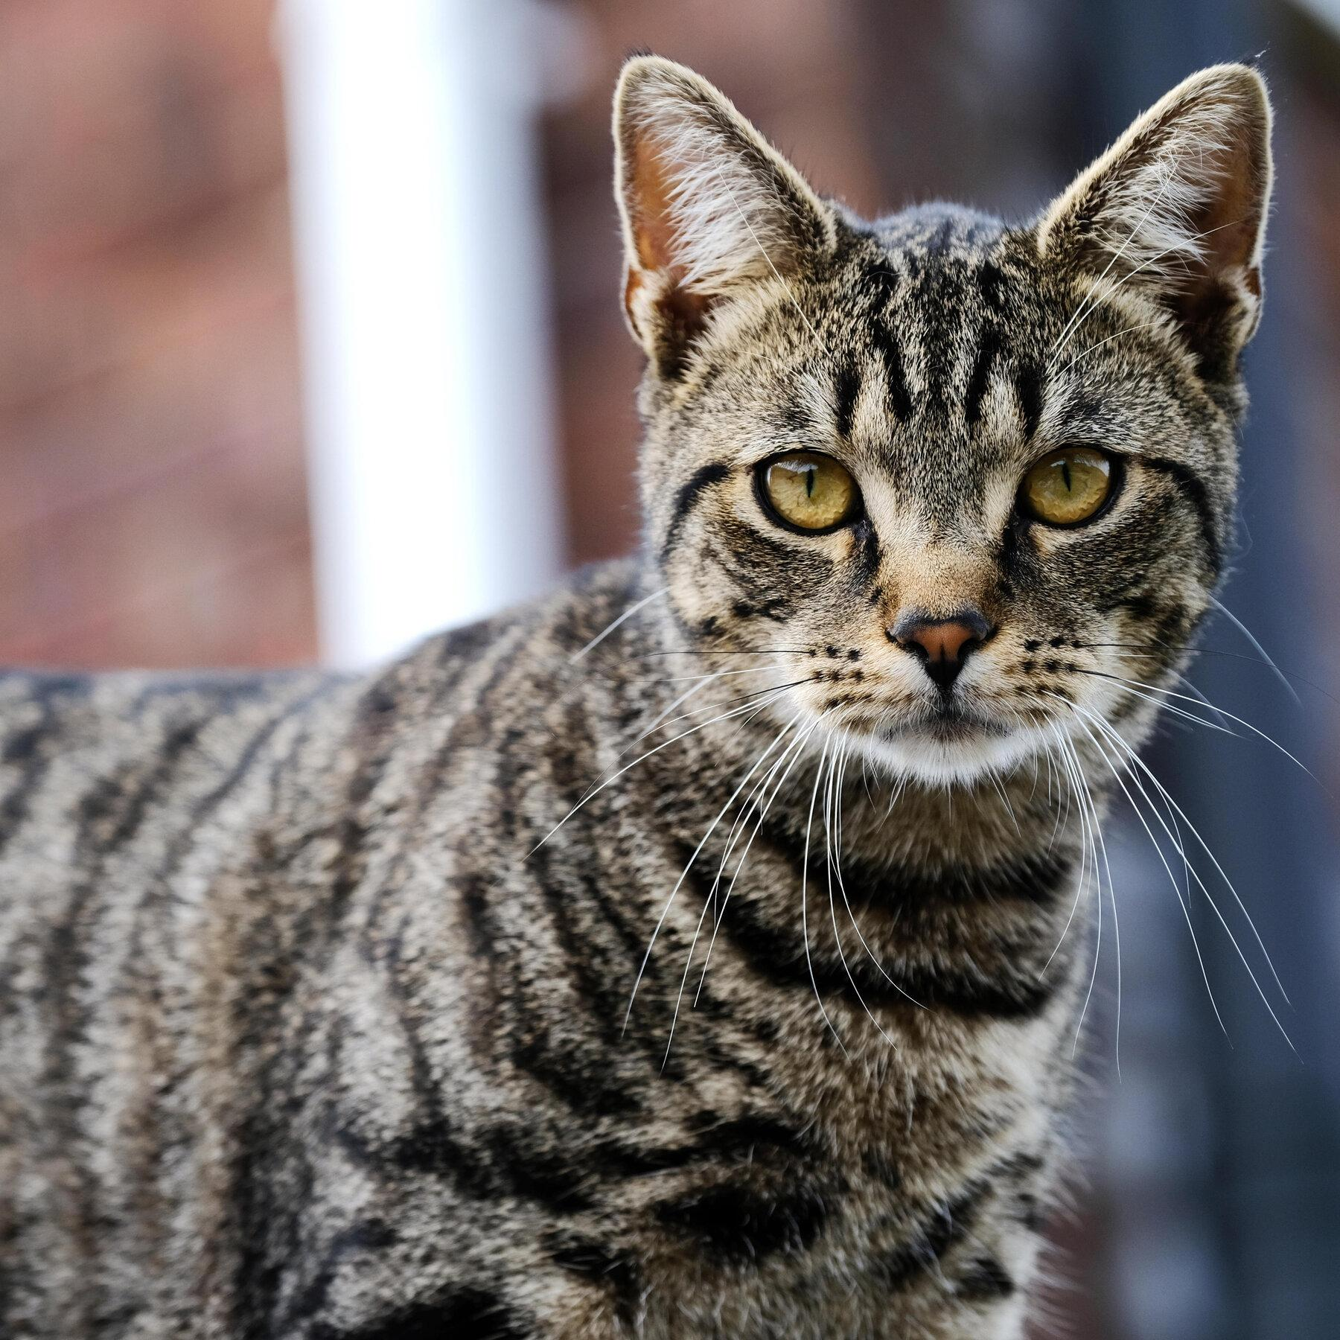
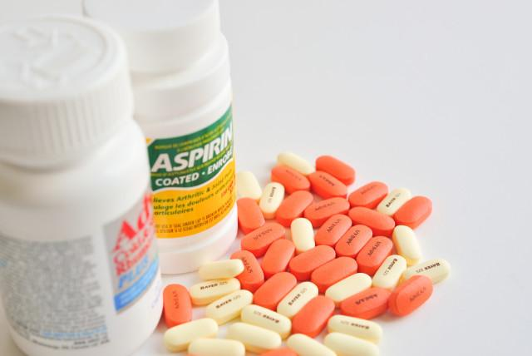

Vaccine Misinfo
Jessica
4 hrs
Shirley
4 hrs
...
...
So we finally know why they want us to get flu vaccines every year. It’s all about collecting our DNA and adding it to their databases so they can easily track and control us.
#DNAfarming #jointheresistance
#wakeup
FACT: 8% of all kids 5-10 have dangerous side-effects from the Moderna vaccine. Do your research and protect your children.
Topics: Vaccine
Topics: Children, Vaccine
Outcomes Slide

Slide 39

Conspiracy Emotions
JohnSands44
4 hrs
...
Trushar
4 hrs
...
They continue silencing us and what we know — Dentists are using dangerous ingredients when they clean your children’s teeth which can lead to a lower IQ.
#savethechildren #knowthetruth #medical choice
They are hiding the truth from you and putting our children in danger. Give your child a tablespoon of garlic and honey each day to prevent measles, not any of the mysterious drugs doctors want to feed to our kids.
Topics: Vaccine, Children
natural remedies
Topics: Children
Back

Slide 40
Misinfo Tactics: 3 each
Back

Slide 41
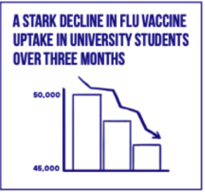
Misleading Charts
We should get examples with better charts. These look non-legit by themselves…
Alexandra
4 hrs
Ali_1958
4 hrs
Do you think it’s a good idea to vaccinate your children?
1,576,674
NO
8,430,222
YES
NEW POLL SHOWS MOST PARENTS AGAINST VACCINES
Support for vaccines has significantly decreased over the years. A new poll shows just how many parents actually support vaccines for children.
Look at this. The chart speaks for itself. They have been lying to us but they can’t hide these statistics.
Topics: Vaccine, Children
Topics: Vaccine
Back

Slide 42
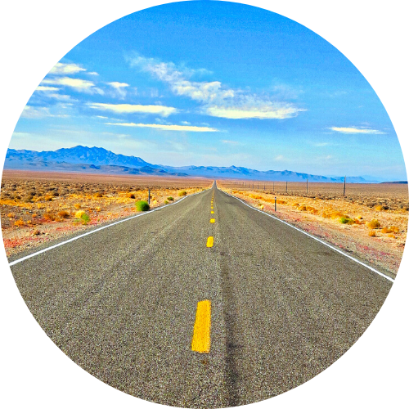
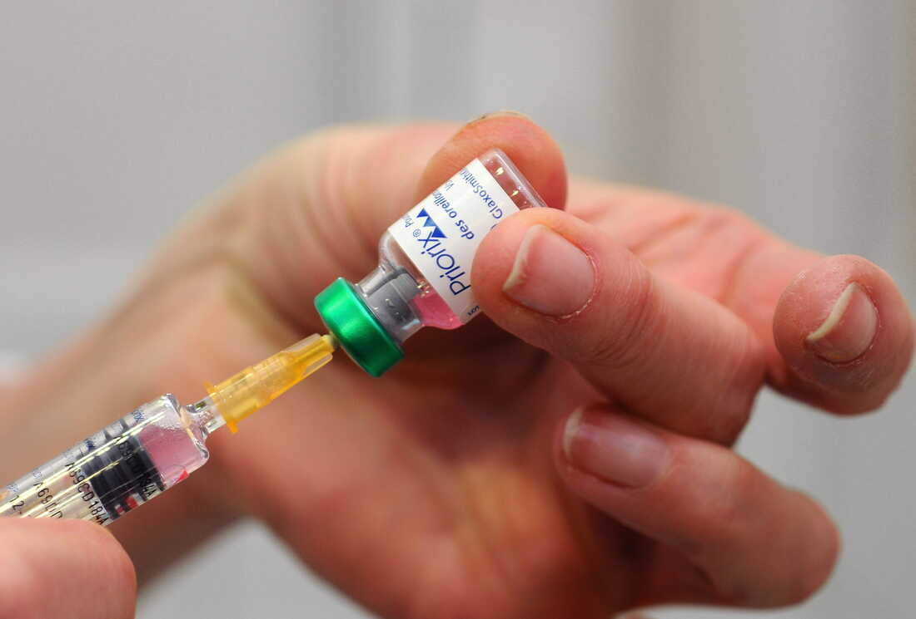

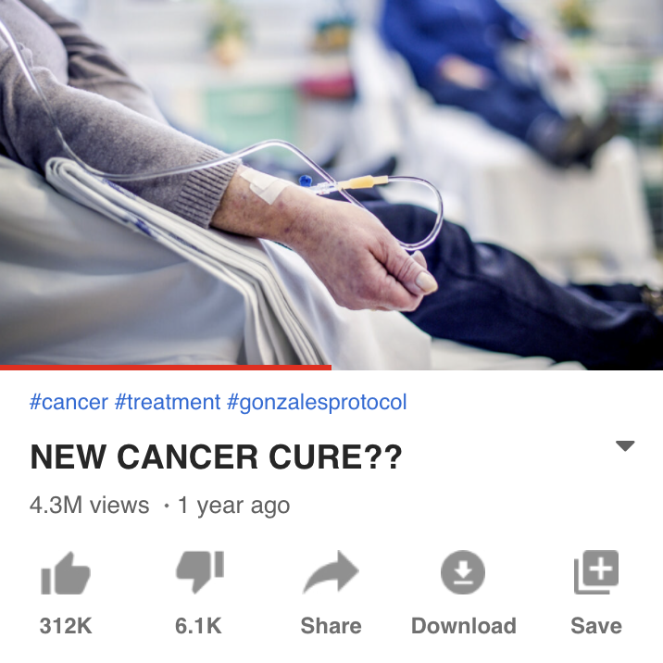
Conspiracy Theories
Lindsay Dunne
4 hrs
David
4 hrs
...
...
The common cold is not a natural virus. We assume it has always been around because we are used to it, but it was first discovered by the US military in 1948.
Autism is a relatively new phenomenon. There are no known records of it before 1943, when scientist Leo Kranner first described it. Research funded by pharmaceutical companies has attempted to discredit links between vaccines and autism, but the evidence doesn’t lie.
Topics: virus, cold, bioweapons
Topics: vaccine, autism, children(?)
Back

Slide 43
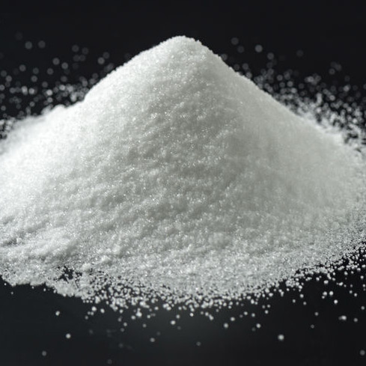
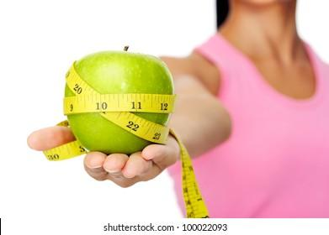
Insider Information
Indrajeet
4 hrs
AJ
4 hrs
...
...
Very important! One of my best friends, who is a doctor, just published a article about how a diet rich in carrots can prevent diabetes. What good news!
My friend is a nurse and she just told me about a BRAND NEW piece of research that will be released soon proving that calories have nothing to do with weight or weight loss.
Topics: diabetes (weight)
Topics: obesity (weight)
Back

